Slide 1

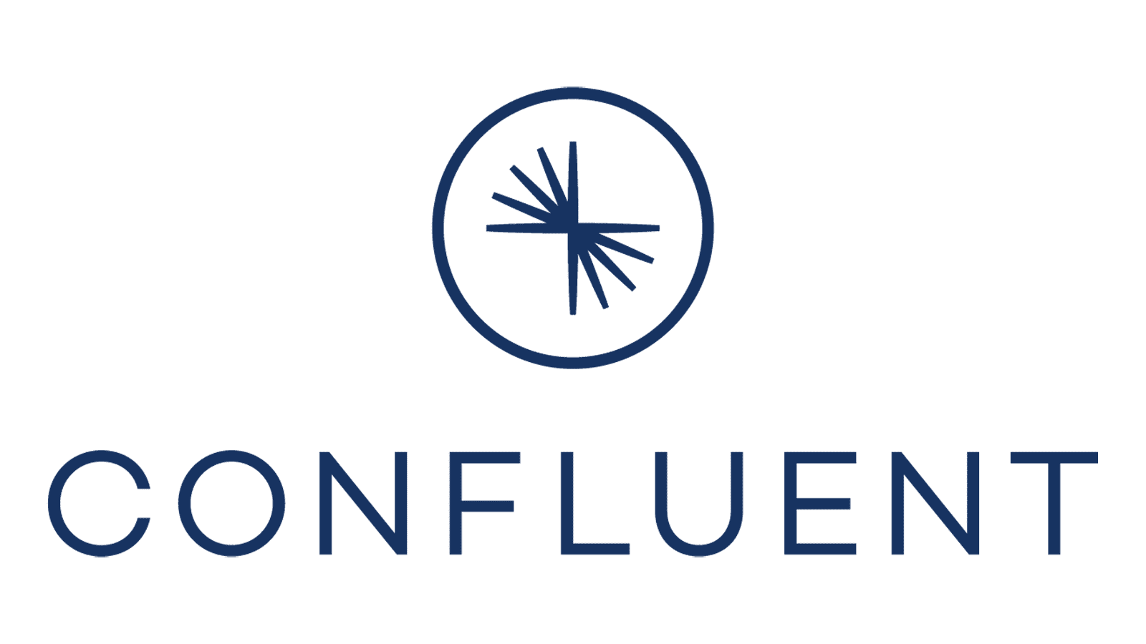
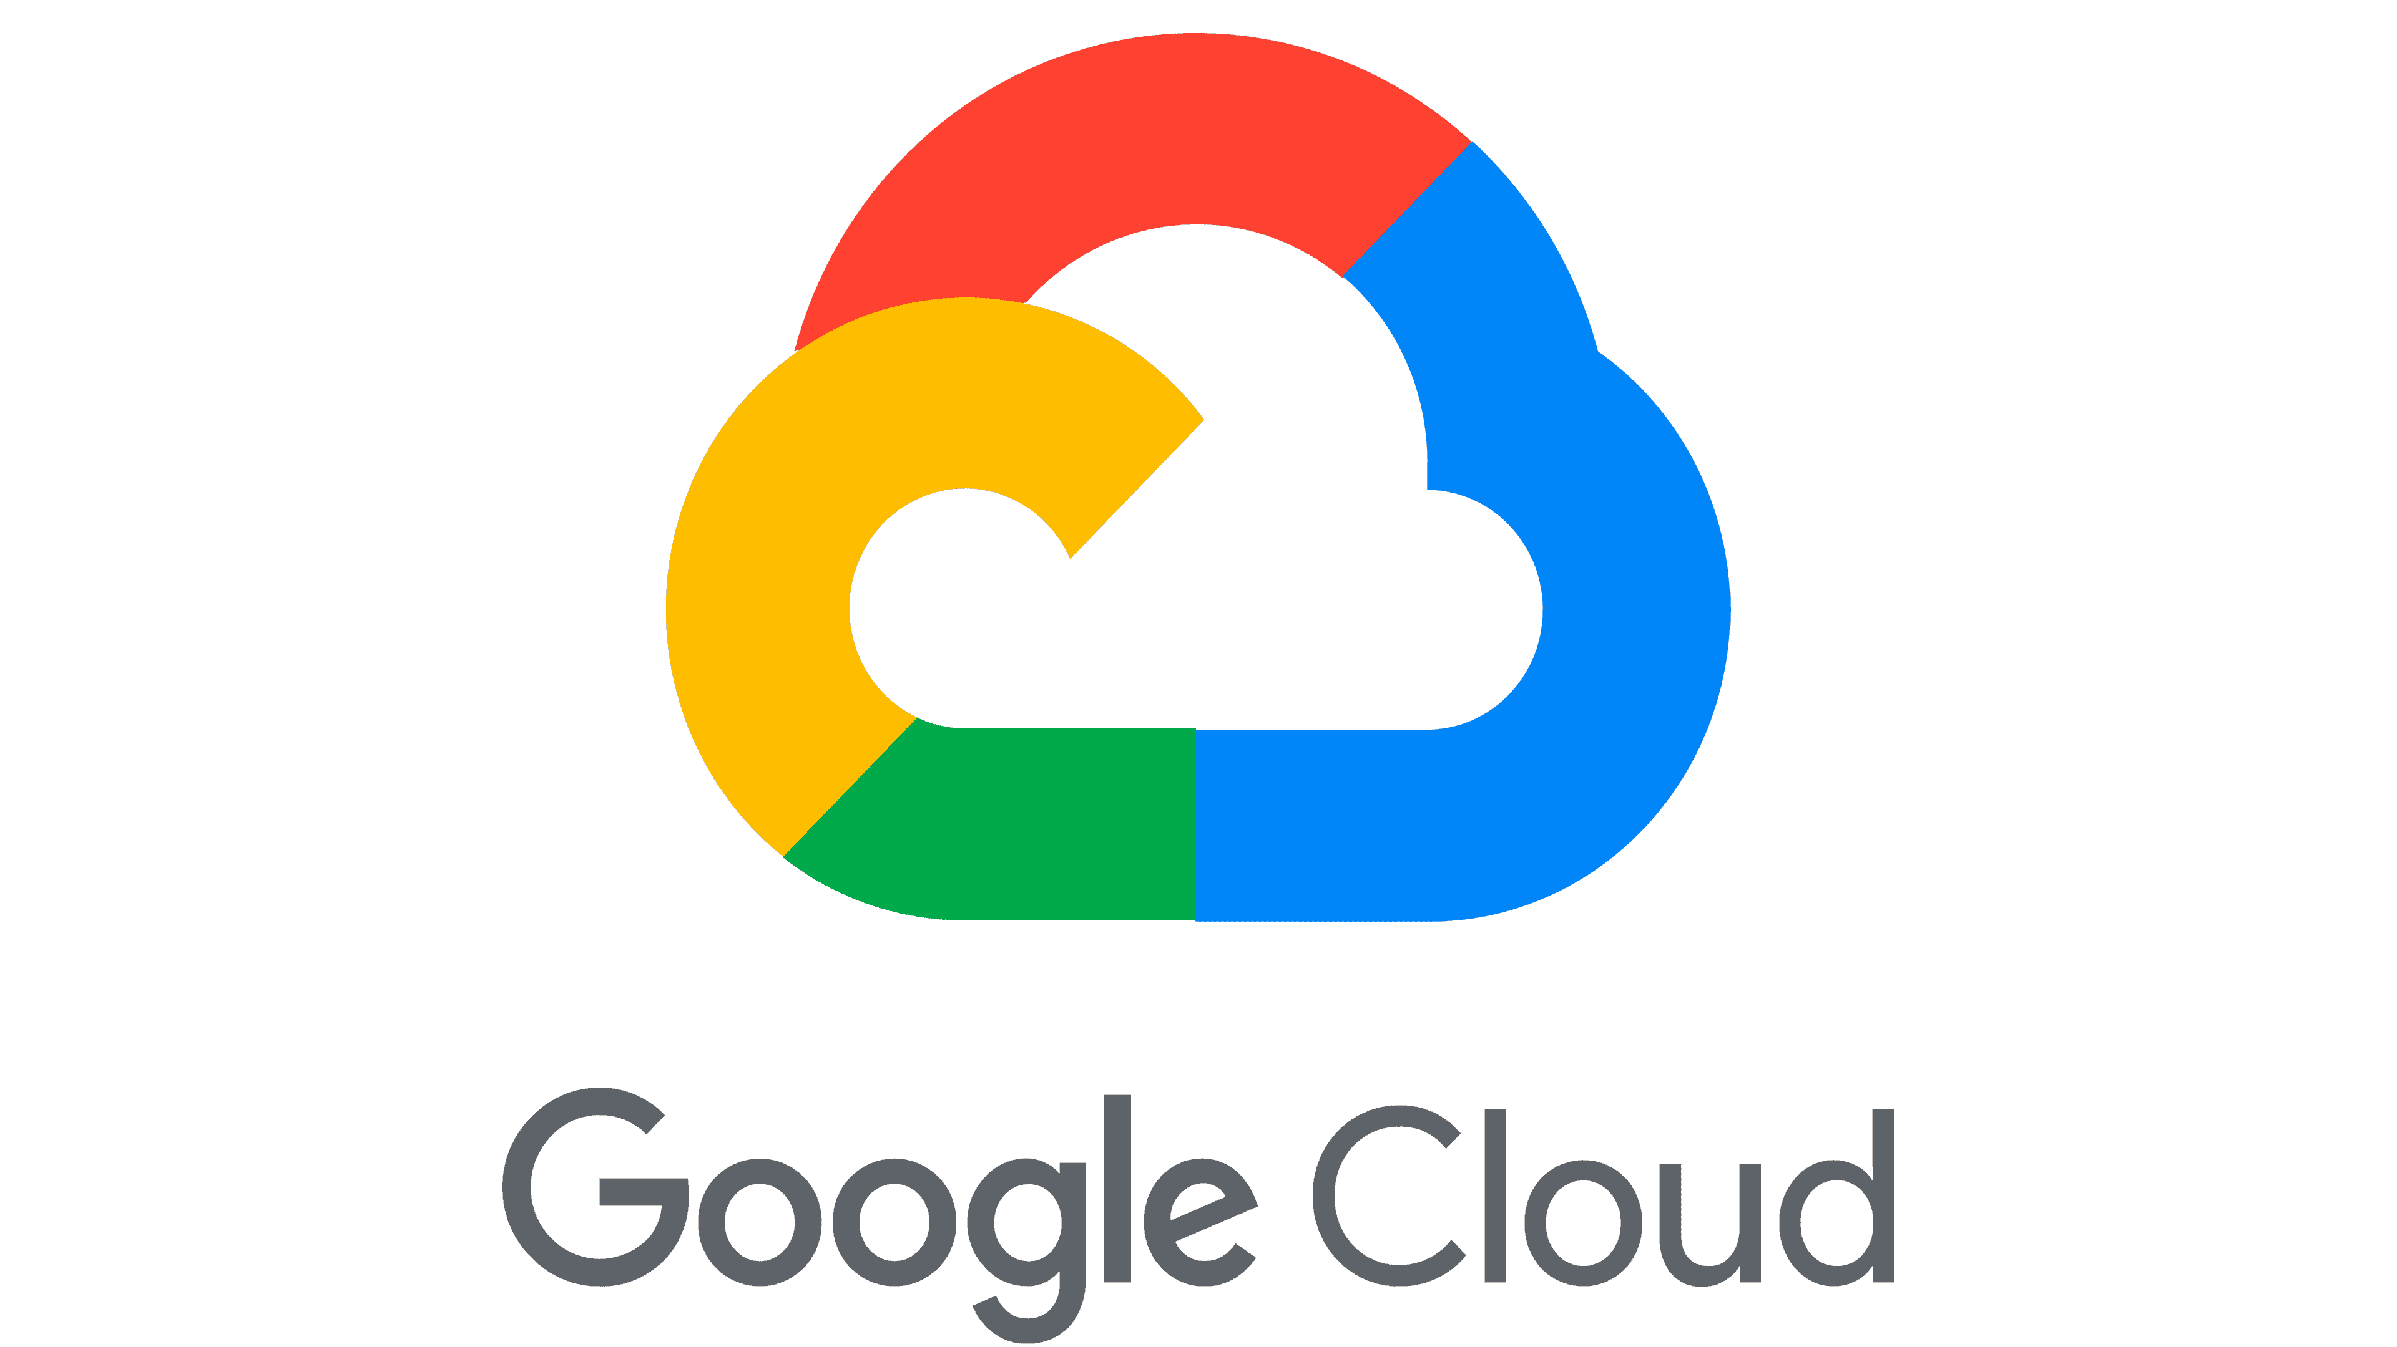
Vertically-Integrated Robotics Manufacturing
Confluent Cloud Workshop on Google Cloud Platform
IBM Build Engineering
December 2026
v2
Notes:
Hello and welcome to this session on semi-headless agent harnesses. With the release of agent harness support from major vendors like Open AI and Claude Code plus open source projects like Open Hands, the shift to agent harnesses and away from hard-coded agent orchestration state graphs is well underway.

Slide 2
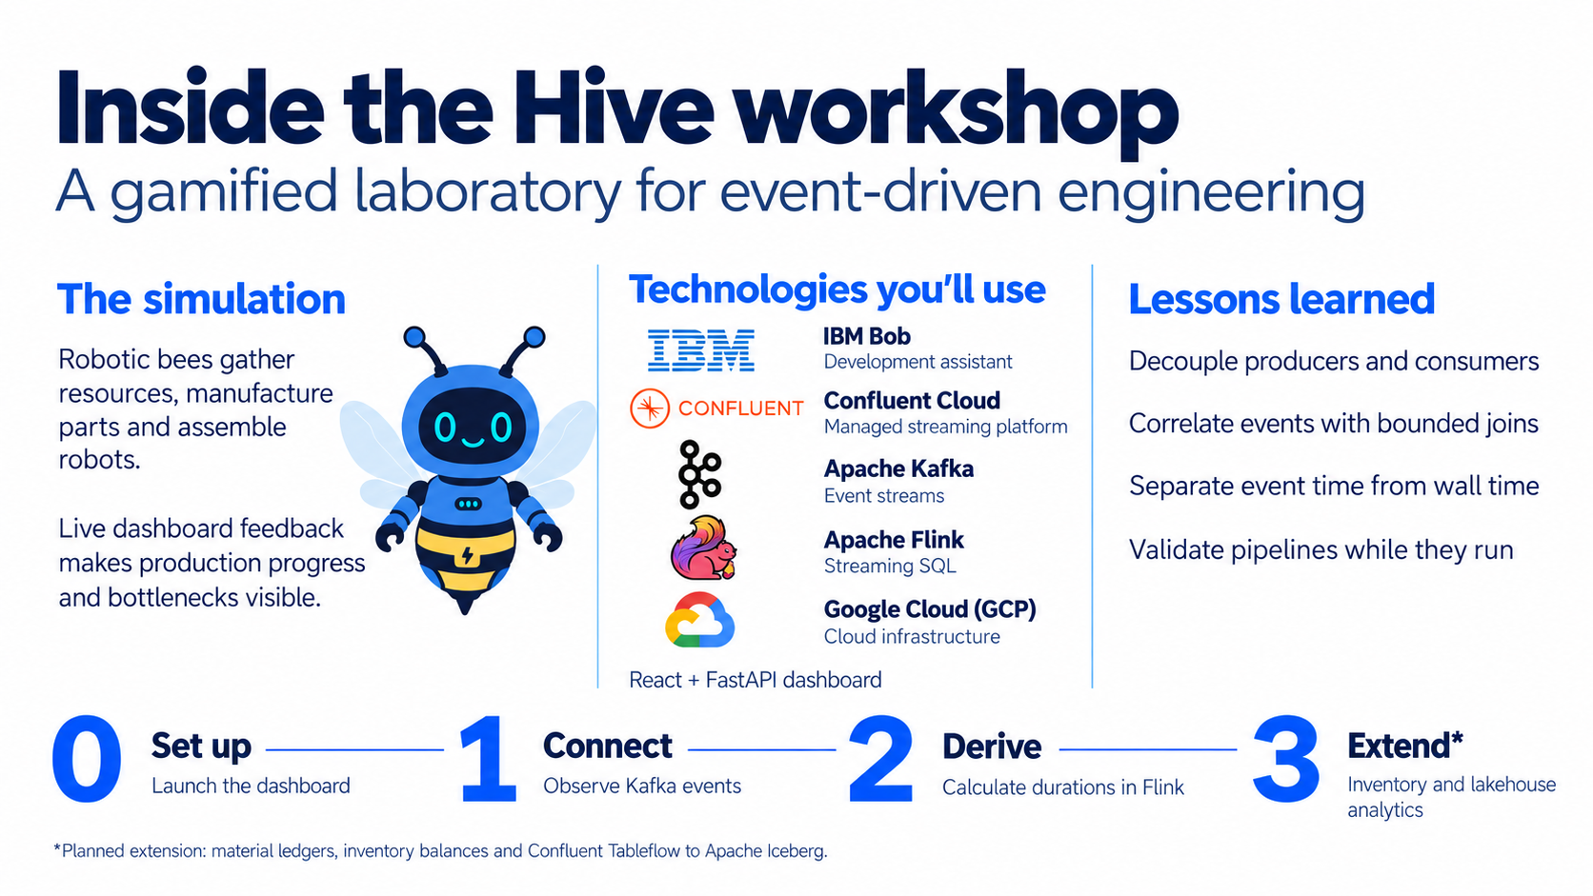

Slide 3
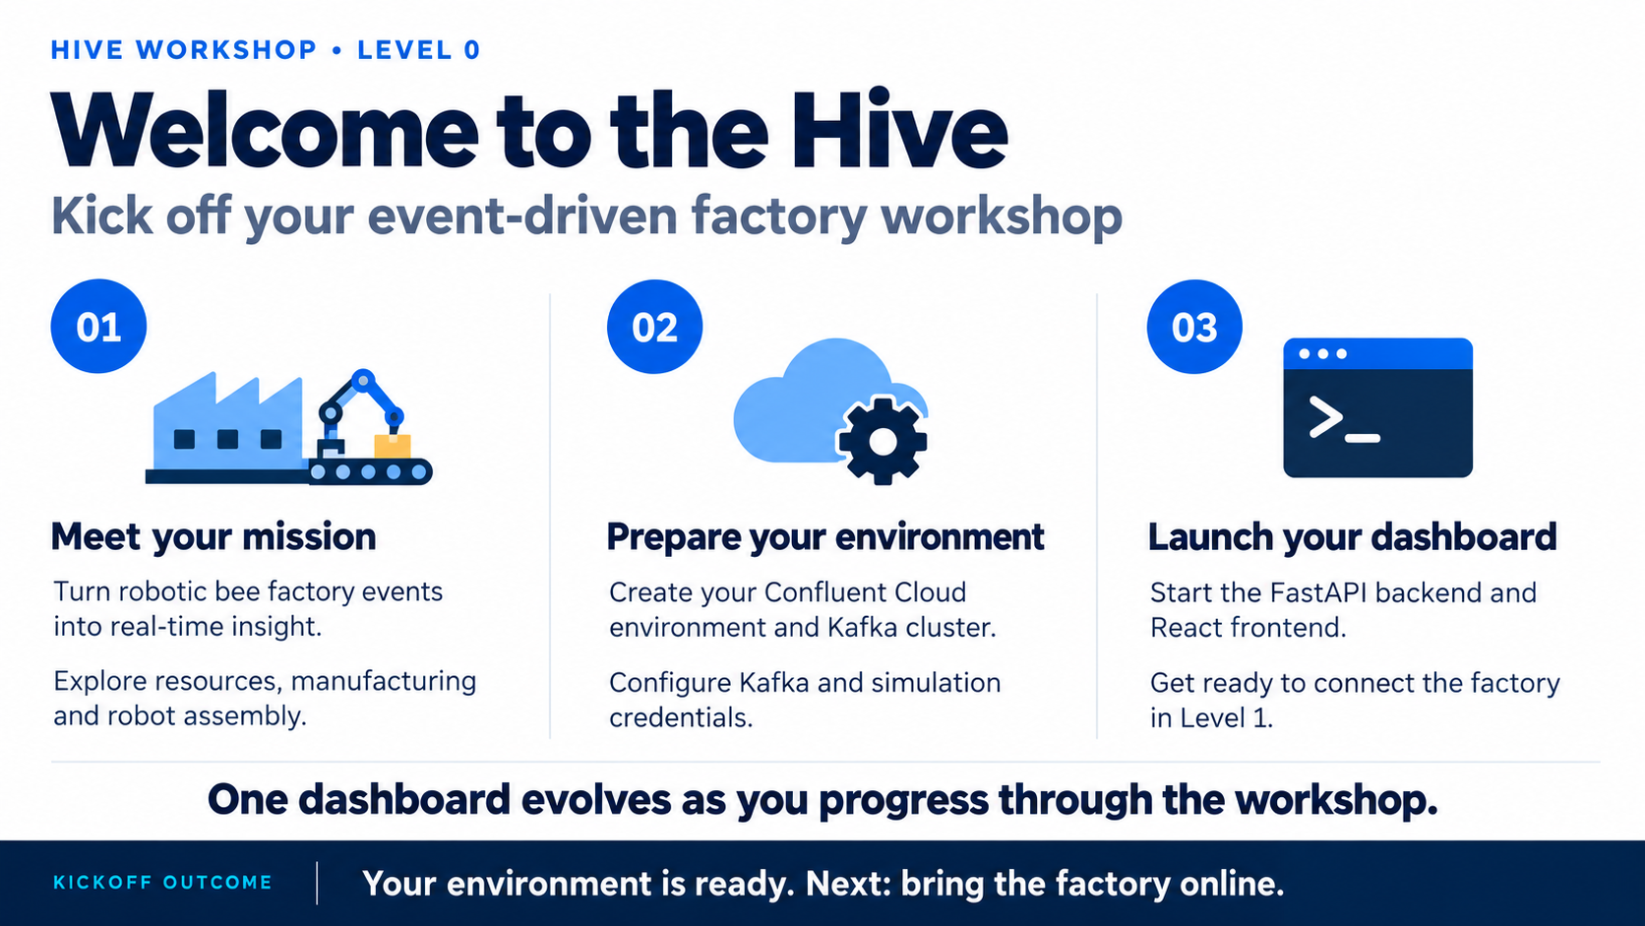

Slide 4
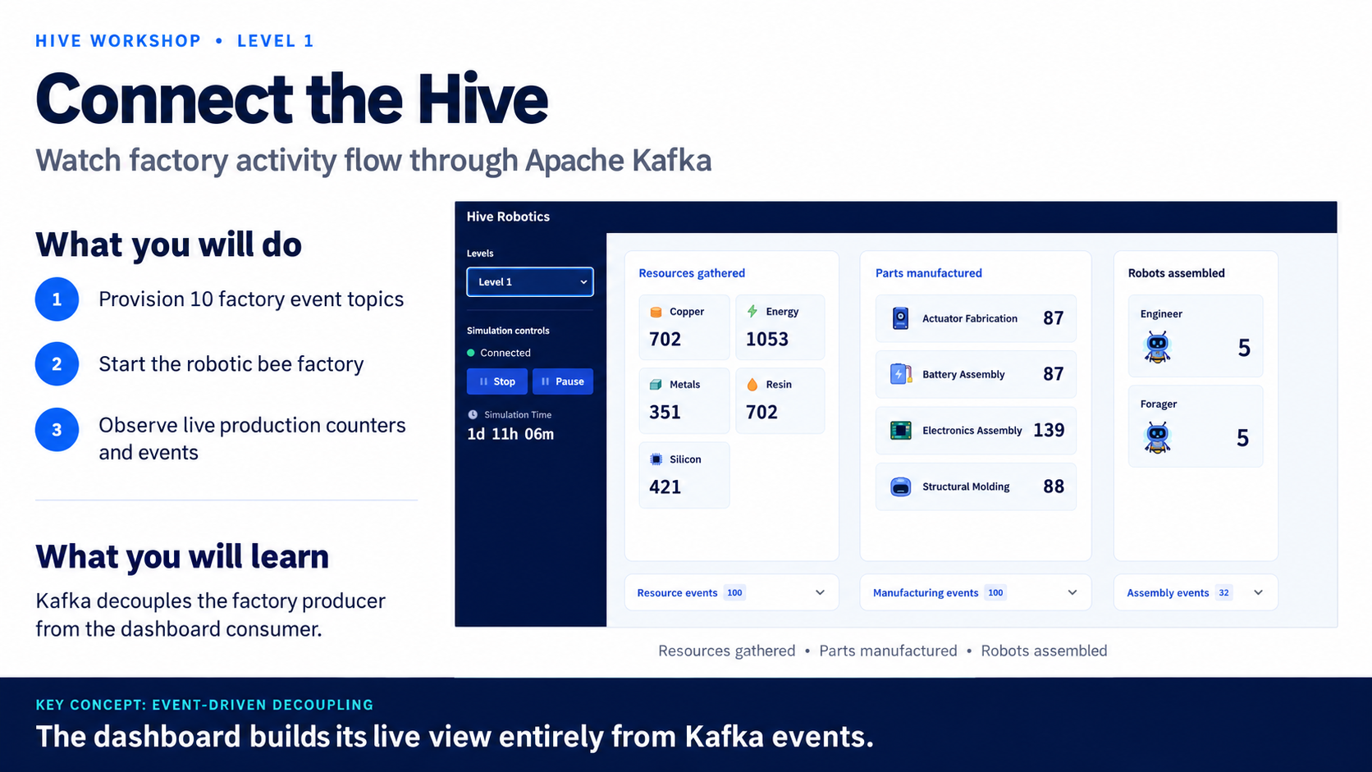

Slide 5
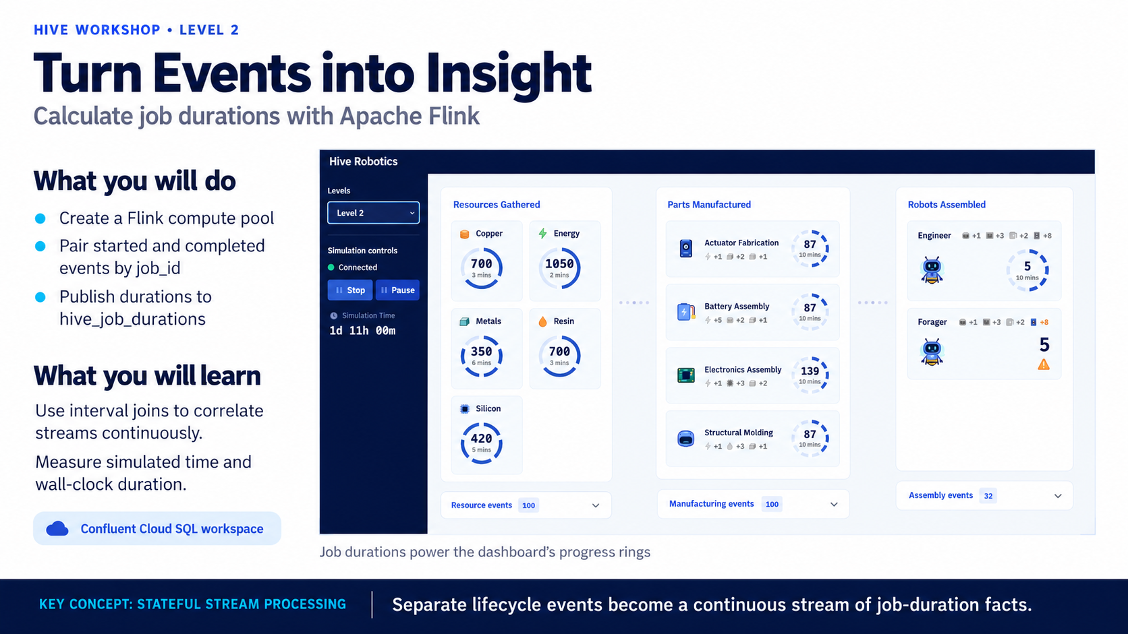

Slide 6
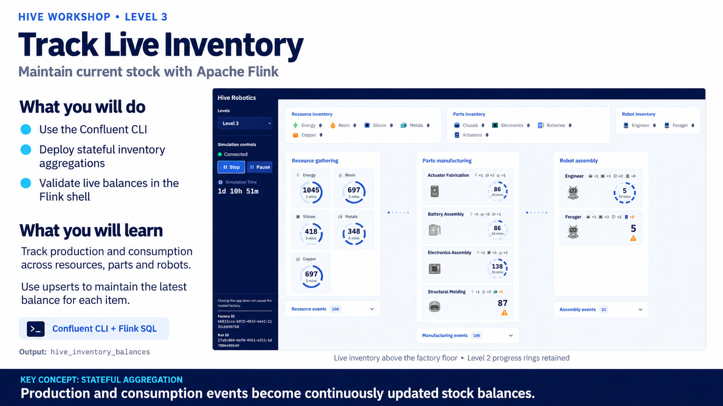

Slide 7
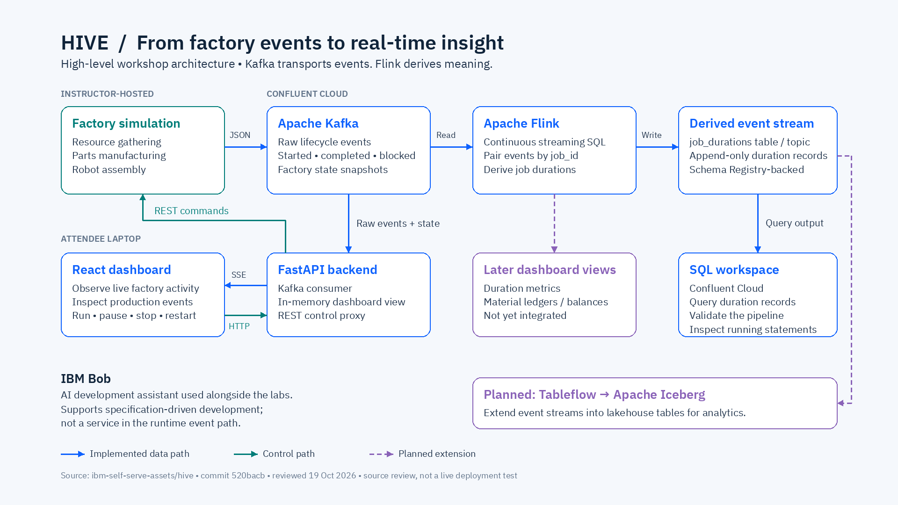

Slide 8
Appendix

Slide 9
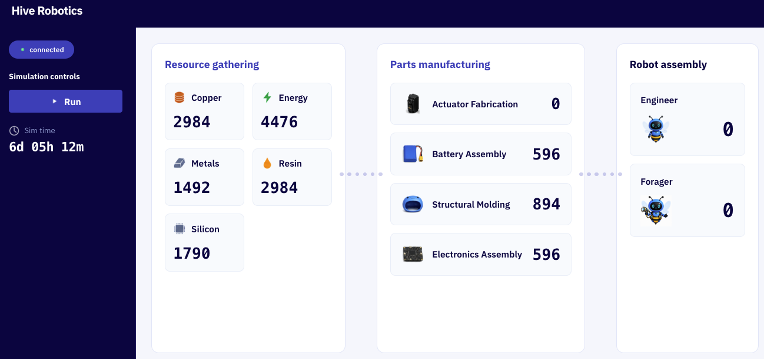
Workshop Level 1
Hive simulation publishes topics to attendee’s Confluent Cloud instance
30 mins
Step 1: Connect to Hive server to Confluent
Attendees provide confluent API keys to the Hive server can published Topics into their Confluent instance.
Example Topics:
gathering.started
gathering.completed
gathering.blocked
manufacturing.started
manufacturing.completed
manufacturing.blocked
assembly.started
assembly.completed
assembly.blocked
Step 2: Visualize Hive simulation
Attendees view their simulation’s evolving state on their personal Hive Robotics dashboard.

Slide 10
Workshop Level 2
Flink configured to extract real-time insights from Simulation topics
30 mins
Real-time insights require windowed calculations over the event stream
Attendees use Flink to calculate system performance and identify bottlenecks in resources and parts availability.
Steps followed by attendees:
Provision Flink using Confluent Cloud UI
Calculate performance metrics from Simulation event stream
Count resources and parts available for downstream manufacturing systems
Filter and join event streams
Identify bottlenecks
Request analysis by agentic harness

Slide 11
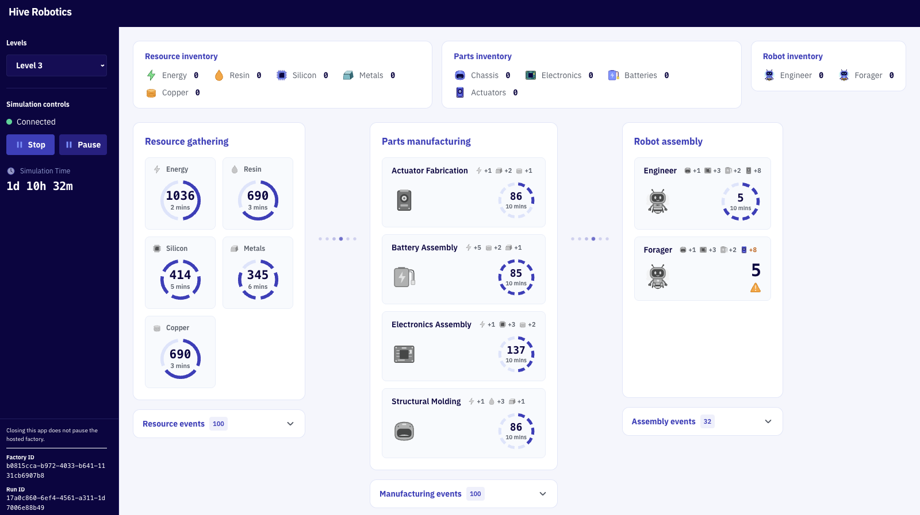
Workshop Level 3
Stream enhanced Topics to Iceberg
30 mins

Slide 12
Workshop Level 4
Deploy containerized headless IBM Bob/Google harnesses to Google Cloud Run
30 mins
Deploy to IBM Bob to Google Cloud Run using IBM Bob
Attendees install IBM Bob and use the provided Google Cloud Run skill to clone and deploy their chosen agentic harness.

Slide 13
Workshop Level 5 (Final )
Optimize Hive simulation using an agentic harness
30 mins
Autonomous Hive Factory Optimization
Headless agentic harnesses are tasked to increase production of the robotics manufacturing factory. MCP Tools are provided so the harnesses to interact with an attendee’s Hive simulation:
MCP Tools
Analysis factory behavior stored in Tableflow’s Iceberg tables
Assign robots to increase manufacturing productivity
Sell robots for Hive currency
Use Hive currency to upgrade manufacturing workstations

